Slide 1
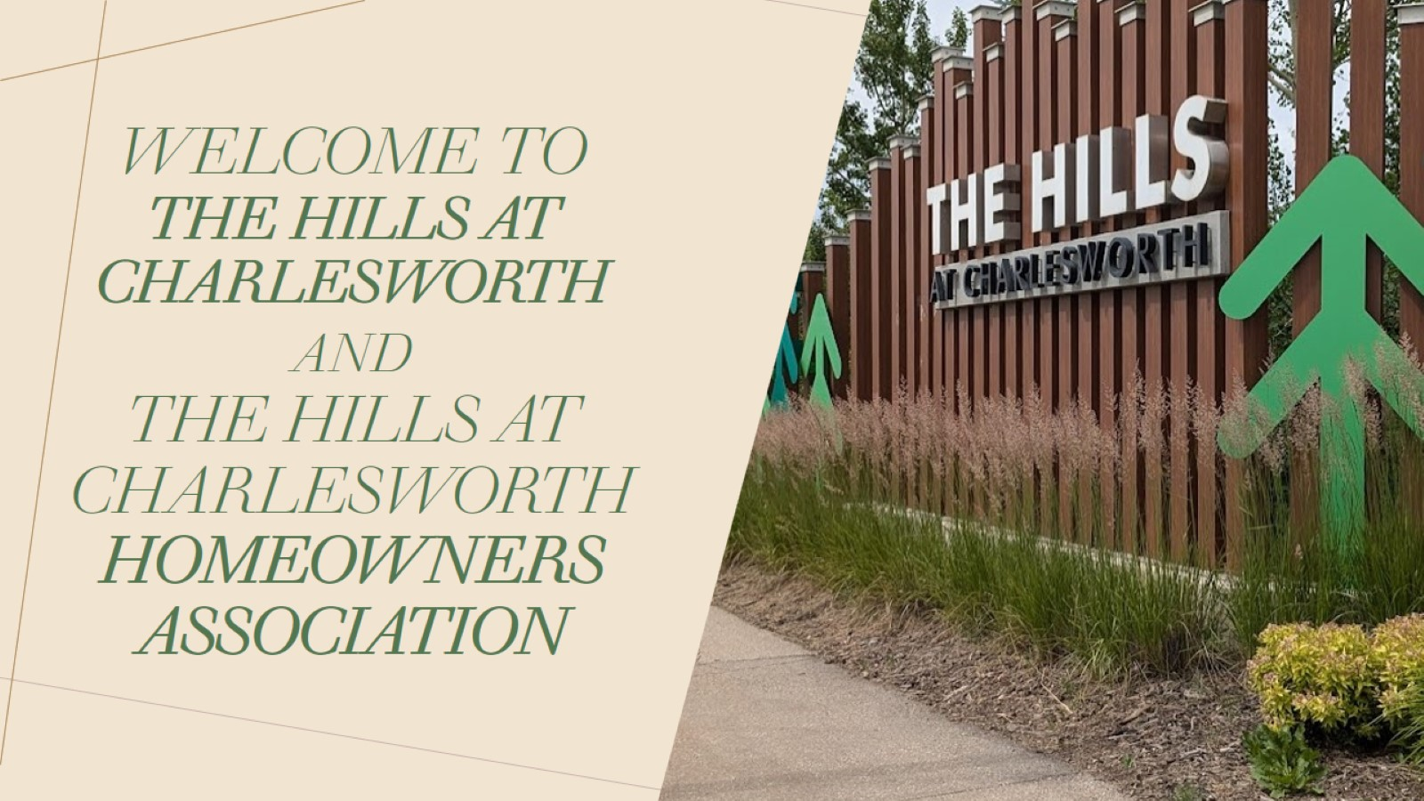
WELCOME TO THE HILLS AT CHARLESWORTH AND THE HILLS AT CHARLESWORTH HOMEOWNERS ASSOCIATION

Slide 2
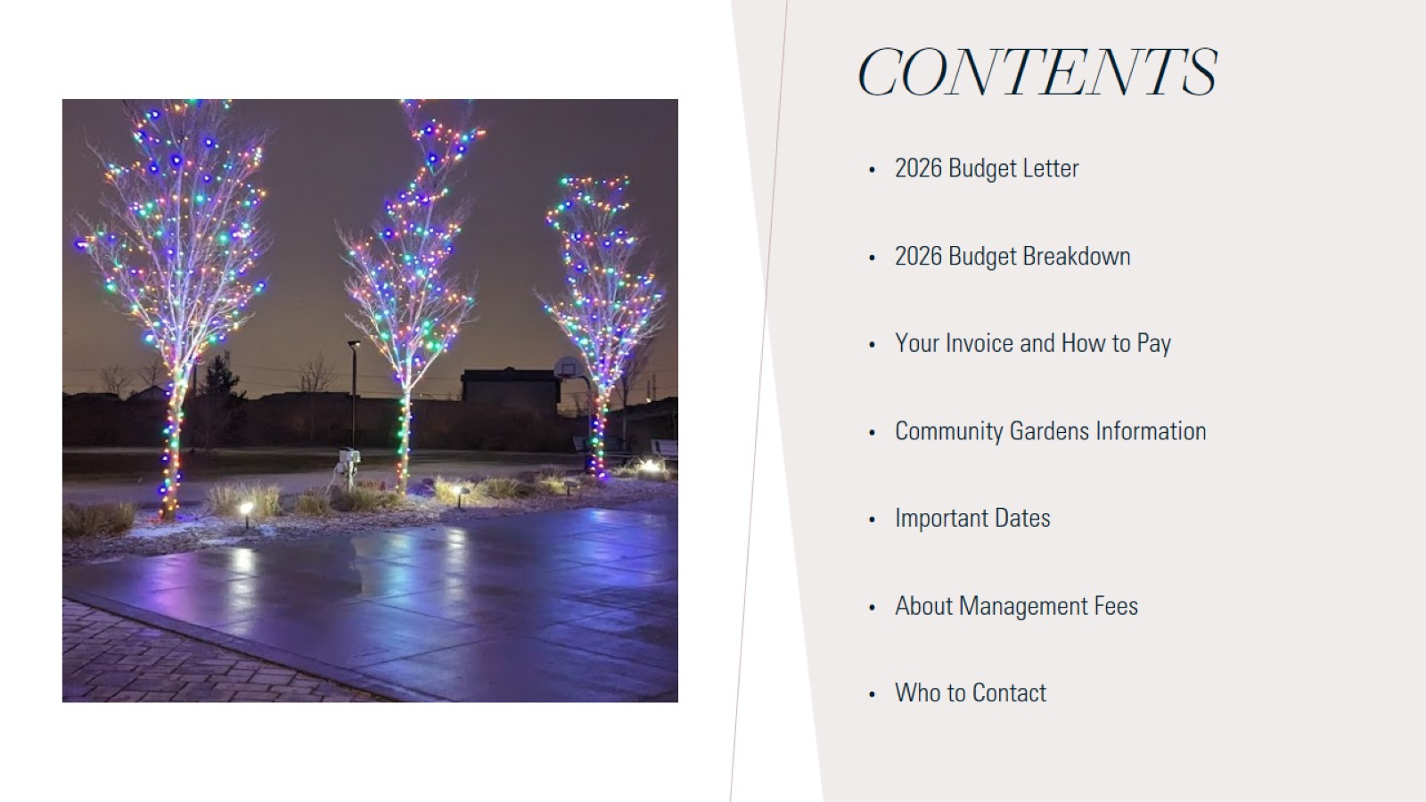
CONTENTS

Slide 3
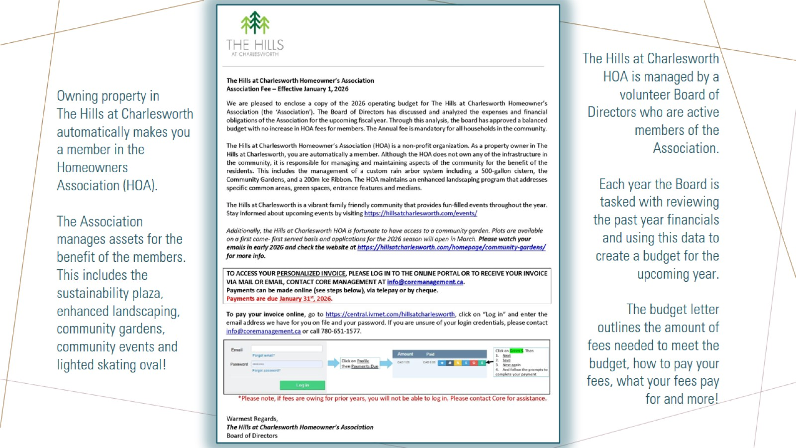

Slide 4


Slide 5
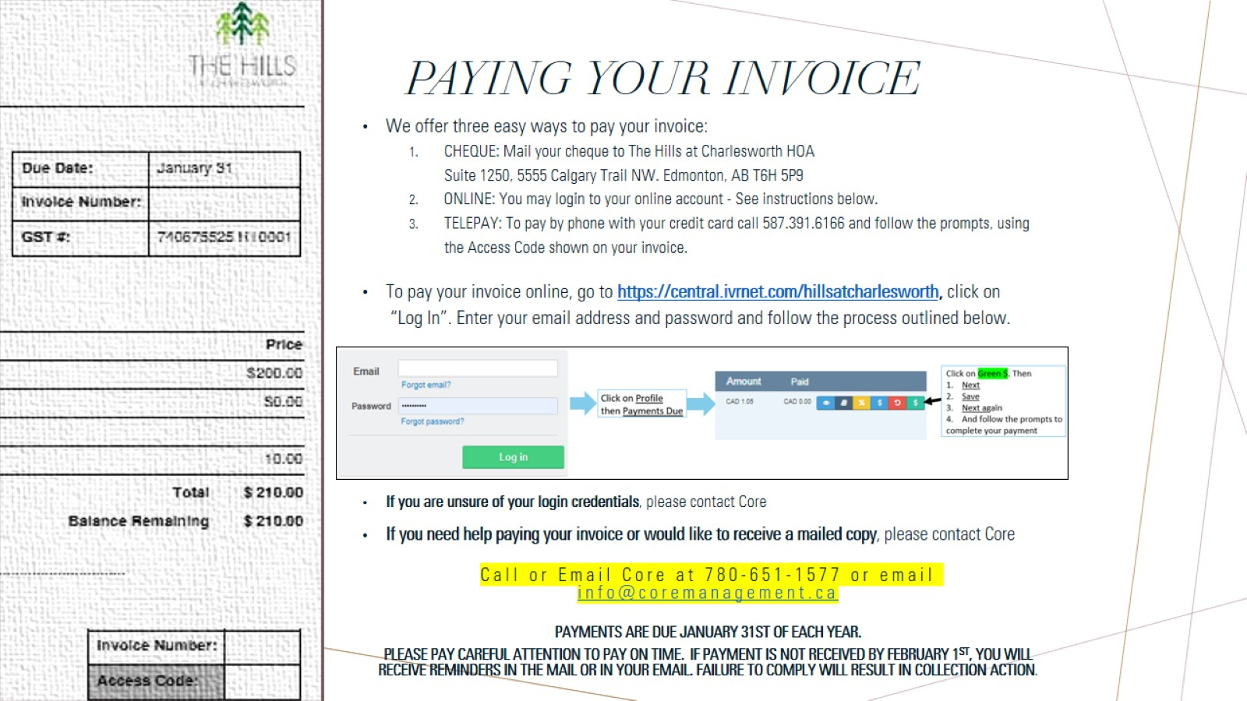
PAYING YOUR INVOICE

Slide 6
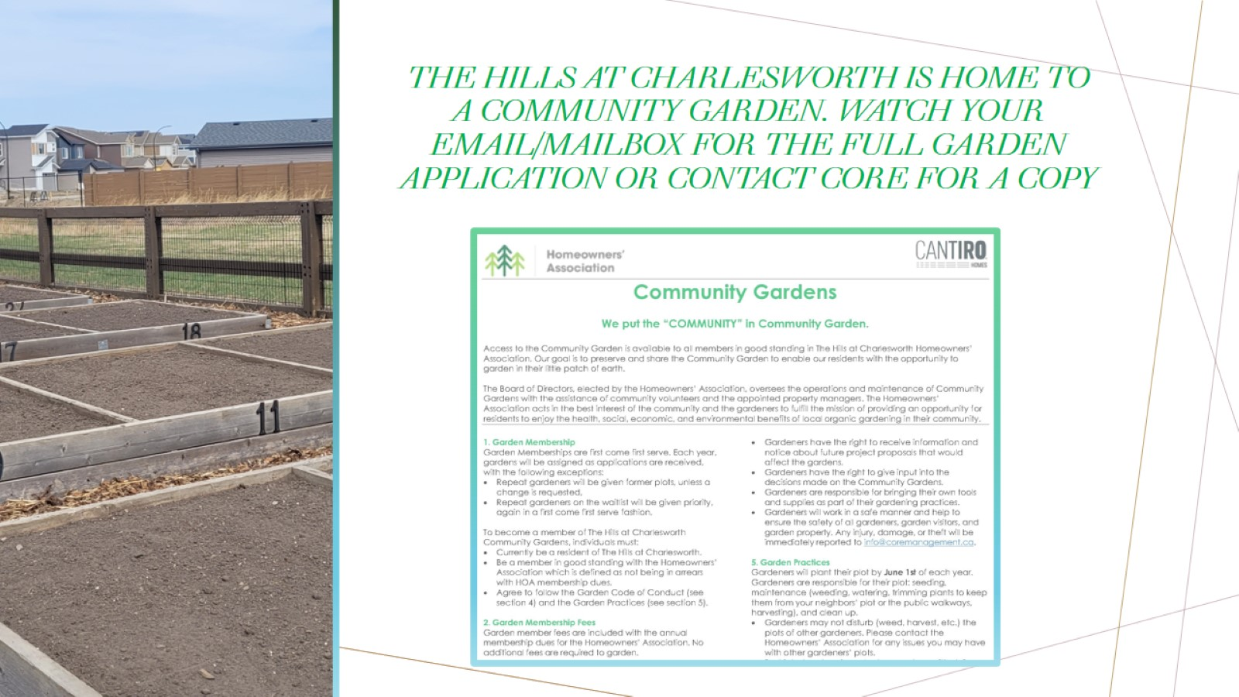
The hills at Charlesworth is home to a community garden. Watch your email/mailbox for the full garden application or contact core FOR A COPY

Slide 7
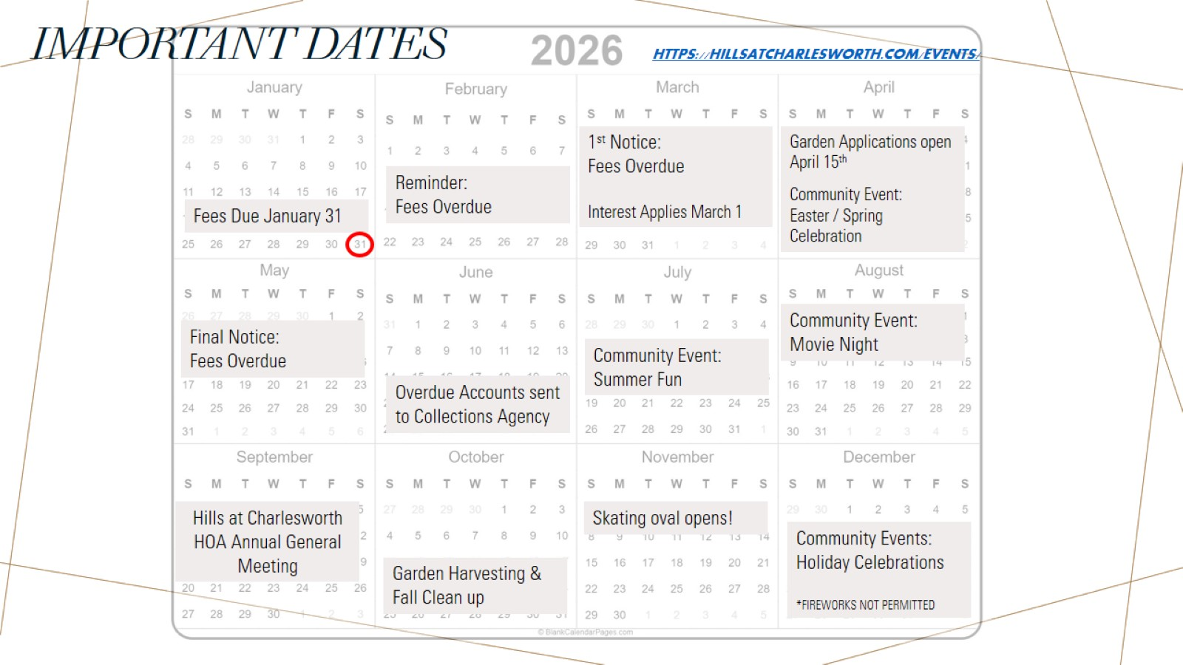
Important dates https://hillsatcharlesworth.com/events/

Slide 8

About Management Fees We are commonly asked what is included in the Management Fees. We understand that this is a large budget item. The Management Fee is for the management of the day-to-day operations of the HOA on behalf of the volunteer Board of Directors. The fees pay for the services of a professional property manager and includes, but is not limited to:

Slide 9

Important Contact info

Slide 10

THANK YOU

